Slide 1
BASIC ITIL TRAINING
ITILv3 Introduction and Overview
SERVICE Strategy
SERVICE Design
SERVICE Transition
SERVICE Operations
Continuous Service Improvements

Slide 2
Introduction & Overview
What is ITIL?
What about v3?
Key Concepts
Service Management & Delivery
The Five Stages of the lifecycle
ITIL Roles
Functions and Processes

Slide 3
What is ITIL?
Systematic approach to high quality IT service delivery
Documented best practice for IT Service Management
Provides common language with well-defined terms
Developed in 1980s by what is now The Office of Government Commerce

Slide 4
What about v3?
ITIL started in 80s.
  40 publications!
v2 came along in 2000-2002
  Still Large and complex
  8 Books
  Talks about what you should do
v3 in 2007
  Much simplified and rationalised to 5 books
  Much clearer guidance on how to provide service
  Easier, more modular accreditation paths
  Keeps tactical and operational guidance
  Gives more prominence to strategic ITIL guidance relevant to senior staff
  Aligned with ISO20000 (1st international standard for IT service management, mostly based on ITIL – 2005)

Slide 5
Key Concepts (1/4)
Service
  Delivers value to customer by facilitating outcomes customers want to achieve without ownership of the specific costs and risks
  e.g. a “backup service” means that you don’t have to care about how much tapes, disks or robots cost and you don’t have to worry if one of the staff is off sick or leaves

Slide 6
Key Concepts (2/4)
Service Level
  Measured and reported achievement against one or more service level targets. E.g.:
    Red = 1 hour response 24/7
    Amber = 4 hour response 8/5
    Green = Next business day
Key Performance Indicators (KPIs)
  Quantifiable measurements that reflect the critical success factors of an organization (KPIs usually are long-term considerations)
Service Level Agreement (SLA)
  Written and negotiated agreement between Service Provider and Customer documenting agreed service levels and costs

Slide 7
Key Concepts (3/4)
Configuration Management System (CMS)
  Tools and databases to manage IT service provider’s configuration data
  Contains Configuration Management Database (CMDB)
    Records hardware, software, documentation and anything else important to IT provision
  Lot of tools vendors: IBM (Tivoli), BMC (Atrium), HP, Microsoft, CA, …
Release
  Collection of hardware, software, documentation, processes or other things require to implement one or more approved changes to IT Services

Slide 8
Key Concepts(4/4)
Incident
  Unplanned interruption to an IT service or an unplanned reduction in its quality
Problem
  Unknown (… as briefly as possible …) underlying cause of one or more incidents
Work-around
  Reducing or eliminating the impact of an incident without resolving it

Slide 9
4 P’s of Service Management
People – skills, training, communication
Processes – actions, activities, changes, goals, improving paths
Products – tools, monitors, measures, documents
Partners – specialist suppliers

Slide 10
Service Delivery Strategies
Strategy | Features
In-sourcing | All parts internal
Out-sourcing | External resources for specific and defined areas (e.g. Contract cleaners)
Co-Sourcing | Mixture of internal and external resources
Knowledge Process Outsourcing (domain-based business expertise) | Outsourcing of particular processes, with additional expertise from provider
Application Outsourcing | External hosting on shared computers – applications on demand (e.g. Survey Monkey, Meet-o-matic)
Business Process Outsourcing | Outsourcing of specific processes e.g. HR, Library Circulation, Payroll
Partnership/Multi-sourcing | Sharing service provision over the lifecycle with two or more organisations

Slide 11
Service Delivery Levels
SaaS – Software as a Service
PaaS – Platform as a Service
IaaS – Infrastructures as a Service
Application SW
OS & Middleware
HW & Bld Infrastructures

Slide 12
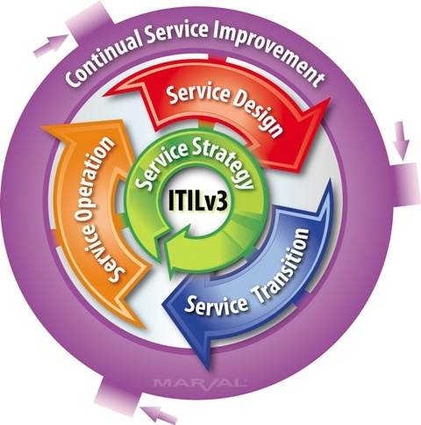
Service Lifecycle & 5 Lifecycle Stages

Slide 13
Processes & Functions
Process
  Structured set of activities designed to accomplish a defined objective
  Inputs & Outputs
  Measurable
Function
  Team or group of people and tools they use to carry out one or more processes or activities
  Own practices and knowledge body

Slide 14
ITIL Roles (Owner vs. Manager)
Process Owner
  Ensures Fit for Purpose
Process Manager
  Monitors and Reports on Process
Service Owner
  Accountable for Delivery
Service Manager
  Responsible for initiation, transition and maintenance. Lifecycle!

Slide 15
… more Roles
Business Relationship Manager
Service Asset & Configuration
  Service Asset (resources) Manager
  Service Knowledge (capabilities) Manager
  Configuration Manager
  Configuration Analyst
  Configuration Librarian
  CMS tools administrator

Slide 16
The 5 Service Lifecycle Stages
Service Strategy
  Strategy generation
  Financial management
  Service portfolio management
  Demand management
Service Design
  Capacity, Availability, Info Security Management
  Service level & Supplier Management
Service Transition
  Planning & Support
  Release & Deployment
  Asset & Config management
  Change management
  Knowledge Management
Service Operation
  Problem & Incident management
  Request fulfilment
  Event & Access management
Continual Service Improvement
  Service measurement & reporting
  7-step improvement process

Slide 17
Stage 1 – Service Strategy
What are we going to provide?
Can we afford it?
Can we provide enough of it?
How do we gain competitive advantage?
Perspective
  Vision, mission and strategic goals
Position
Plan
Pattern
  Must fit organisational culture

Slide 18
Service Strategy has four activities
Define the Market
Develop the Offerings
Develop Strategic Assets
Prepare for Execution

Slide 19
Service Assets
Resources
  Things you buy or pay for
  IT Infrastructure, people, money
  Tangible Assets
Capabilities
  Things you grow
  Ability to carry out an activity
  Intangible assets
  Transform resources into Services

Slide 20
Service Portfolio Management
Prioritises and manages investments and resource allocation
Proposed services are properly assessed
  Business Case
Existing Services Assessed. Outcomes:
  Replace
  Rationalise
  Renew
  Retire

Slide 21
Demand Management
Ensures we don’t waste money with excess capacity
Ensures we have enough capacity to meet demand at agreed quality
Patterns of Business Activity to be considered
  E.g. Economy 7 electricity, Congestion Charging, …

Slide 22
Stage 2 – Service Design
How are we going to provide it?
How are we going to build it?
How are we going to test it?
How are we going to deploy it?
Holistic approach to determine the impact of change introduction on the existing services and management processes

Slide 23
Processes in Service Design
Service Catalogue Management
Service Level Management
Capacity Management
Information Security Management
Availability Management
ITSCM (disaster recovery)
Supplier Management

Slide 24
P#1 – Service Catalogue
Business Process A
Business Process B
Business Process C
Business Service Catalogue
Service 1
Service 2
Service 3
Service 4
Service 5
Service 6
Technical Service Catalogue
Hardware
Software
Support
Applications
Databases
Capability
Keeps service information away from business information
Provides accurate and consistent information enabling service-focussed working

Slide 25
P#2 – Service Level Management
Service Level Agreement (SLA)
  Operational Level Agreements
    Internal
  Underpinning Contracts (“SLAs are for service management, contract is for the court ...”)
    External Organisation
    Supplier Management
  Generally an annexe to a contract
  Should be clear and fair and written in easy-to-understand, unambiguous language
Success of SLM: Key Performance Indicators (KPIs)
  How many services have SLAs?
  How does the number of breaches of SLA change over time (we hope it reduces!)?

Slide 26
Things you might find in an SLA
Service Description
Hours of operation
User Response times
Incident Response times
Resolution times
Availability & Continuity targets
Customer Responsibilities
Critical operational periods
Change Response Times

Slide 27
Types of SLA
Service-based
  All customers get same deal for same services
Customer-based
  Different customers get different deal (and different cost)
Multi-level
  These involve corporate, customer and service levels and avoid repetition

Slide 28
SLA, an example
Online Services Availability
  Minutes of service unavailability
  Period 1 definition: MON-FRI 8-18
  Period 2 definition: other
  Observation interval 1 YEAR:
    “Inappropriate” SL: more than 523 min/year in period 1, more than 680 in period 2
    “Insufficient” SL: more than 756 min/year in period 1, more than 983 in period 2
    “Unsuitable” SL: more than 1.047 min/year in period 1, more than 1.361 in period 2
  Observation interval 1 MONTH:
    “Inappropriate” SL: n/a
    “Insufficient” SL: n/a
    “Unsuitable” SL: more than 209 min/month in period 1, more than 272 in period 2

Slide 29
SLA, more examples
Online Services Performance
  Transactions mean response time ≤ 2,5 sec
  Maximum percentage of transactions ending in more than 1 sec = 5%
DR Service
  RTO (Recovery Time Option):
    Applications A, B, C, ... restarting in 2 hours after the disaster formal statement
    Applications X, Y, Z, ... restarting in 24 hours after the disaster formal statement
  RPO (Recovery Point Option):
    No data loss for applications A, B, C, ...
    Maximum data loss for applications X, Y, Z, ... updates in the last hour before the disaster

Slide 30
P#3 – Capacity Management
Right Capacity, Right Time, Right Cost!
Balances Cost against Capacity so minimises costs while maintaining quality of service

Slide 31
P#4 – Information Security Management
Confidentiality
  Making sure only those authorised can see data
Integrity
  Making sure the data is accurate and not corrupted
Availability
  Making sure data is supplied when it is requested

Slide 32
P#5 – Availability Management
Ensure that IT services are available … minimum at the agreed targets
Lots of Acronyms
  Mean Time Between Service Incidents
  Mean Time Between Failures
  Mean Time to Restore Service
Resilience increases availability
  Service can remain functional even though one or more of its components have failed

Slide 33
P#6 – ITSCM
IT Service Continuity Management
Ensures resumption of services within agreed timescale
Business Impact Analysis informs decisions about resources
  E.g. Stock Exchange can’t afford 5 minutes downtime but 2 hours downtime probably wont badly affect a departmental accounts office or a college bursary

Slide 34
Standby for lift-off...
Cold
  Accommodation and environment ready but no IT equipment ➔ … WEEKS
Warm
  As cold plus backup IT equipment to receive data ➔ … 24 ÷ 48 HOURS
Hot
  Full duplexing, redundancy and failover ➔ … MINUTES ÷ COUPLE of HOURS

Slide 35
… not to be confused …
Availability Management
  The process that defines SLA on IT Services availability and provides their compliance
Continuity Management
  The process by which PROACTIVE measures are put in place and managed to ensure that IT Services can continue should an incident occur
Disaster Recovery
  A set of REACTIVE processes activated to recover IT Services after a serious incident has occurred
Contingency Plan
  A set of business emergency procedures to be used during missing or severe defecting IT Services

Slide 36
P#7 – Supplier Management
To ensure that all contracts with suppliers support the needs of the business, and that all suppliers meet their contractual commitments:
  Providing the Supplier Management Framework
  Evaluation of New Suppliers and Contracts
  Establishing New Suppliers and Contracts
  Processing of Standard Orders
  Supplier and Contract Review
  Contract Renewal or Termination

Slide 37
Service Transition Process
PLANNING
KNOWLEDGE ACQUISITION
SHADOWING
(RESERVE)
SERVICE OWNERSHIP
Define support scope and discover responsibilities
Detailed scope description with clear responsibilities definition for each related item represented in scope
Organizational preparations and arrangements
Definition of key stakeholders. Team ramp-up plan with responsibilities definition
Knowledge Transfer plan
Create detailed Knowledge Transition plan and describe the roles and responsibilities for KT participants
Acquire access and associated licenses
List of systems and tools with access links and access information, credentials data and timestamps
Support Infrastructure setup
Dedicated phone line, email address, other communication channels
Overview of systems and architecture attributes
Service Areas overview, gaps identification, backfill missing data in documentation
Communication and escalation points establishing
Create communication matrix, define the escalation points
Acquaintance with ticket processing workflow
Ticket Processing Workflow description, ITSM Tool usage guidelines creation
Ticket backlog and history review
Draft issues classification with breakdown by categories and types, define criteria for issues classification
Analyze run book(s) and internal project documentation
Technical Instructions and KB articles with step-by-step guides on performing various kinds of tasks defined in scope
Service Levels and KPI identification
Intermediate drafts of performance and KPI reports including ticket backlog detailed analysis
Post-transfer service provision analysis
KPI metrics and statistic reports analysis
Improvements implementation
Performance reports and analysis showing the improved service level
Transition period closure with established outcome and objectives for operation phase
Operation in compliance with agreed performance targets
Implemented metrics and measurement program, regular status reports, improvement recommendations for service quality enhancement and performance evaluation
DELIVERABLES

Slide 38
Continuous Improvement Program
STEP 2
STEP 3
Define Metrics & KPI’s
Establish RACI & Governance structure
Create an Improvement plan
Implement Improvements based on priority
Control adoption process
Measure, report, and communicate the progress
Build Strategy
Implement
Operation
Design
STEP 1
STEP 4
Transition
Initiate
Set Business Objectives
Define targets in processes, people, technology
Assess Current State
Adjust
Analyze trends, targets, SLAs and benchmarks
Gather & analyze feedbacks from Business, Service and Process owners
Adjust the Improvement Plan

Slide 39
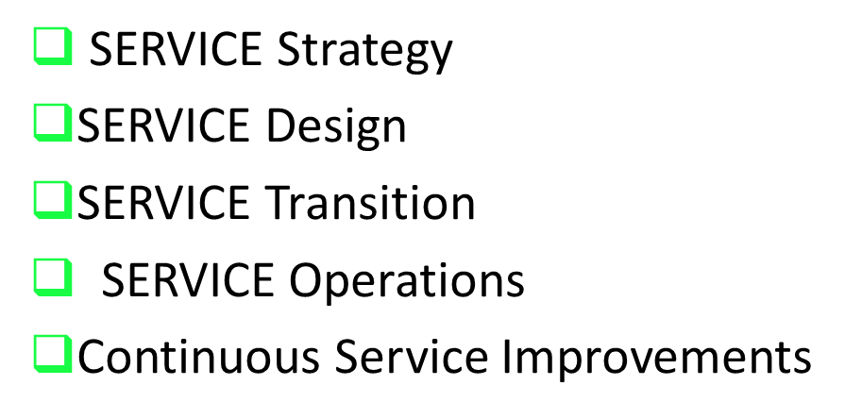
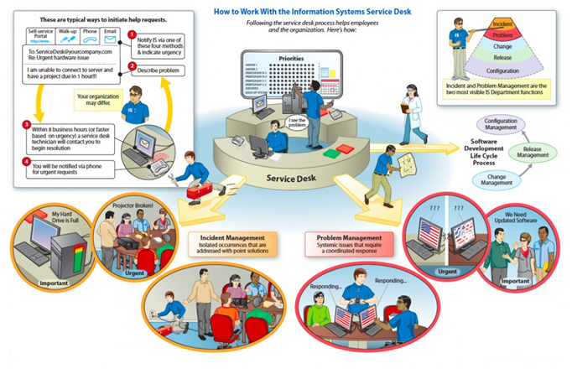
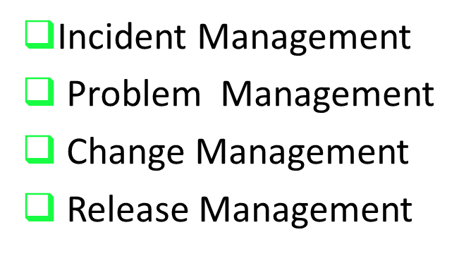
ITIL/ ITSM DRIVEN PROCESS FRAMEWORK IN A NUTSHELL

